Slide 1
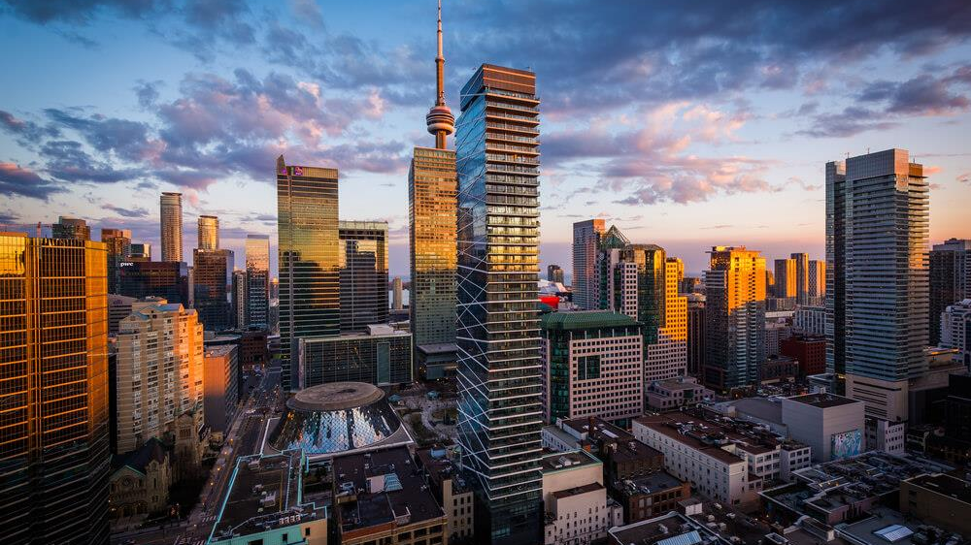
Analysis on Toronto’s Rental Market
Created by: Daniel Tsai

Slide 2
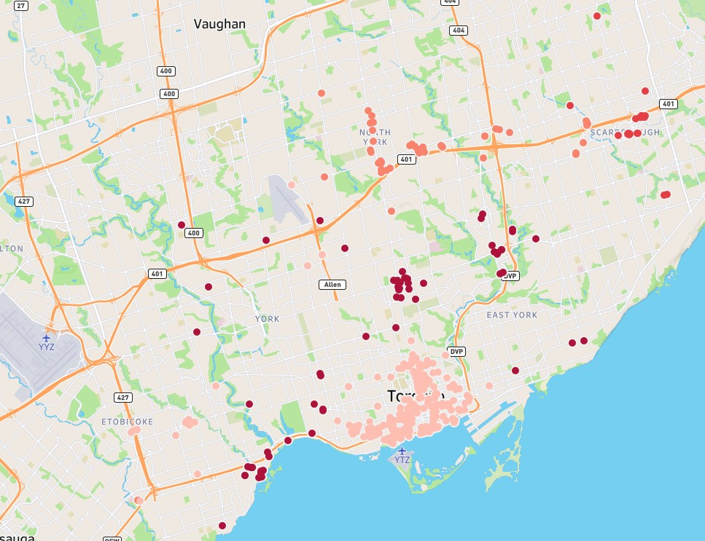
Mapping the Clusters
The dots represent the rental properties for the study
Different shades represent a different cluster label
Clusters spread around the City of Toronto

Slide 3
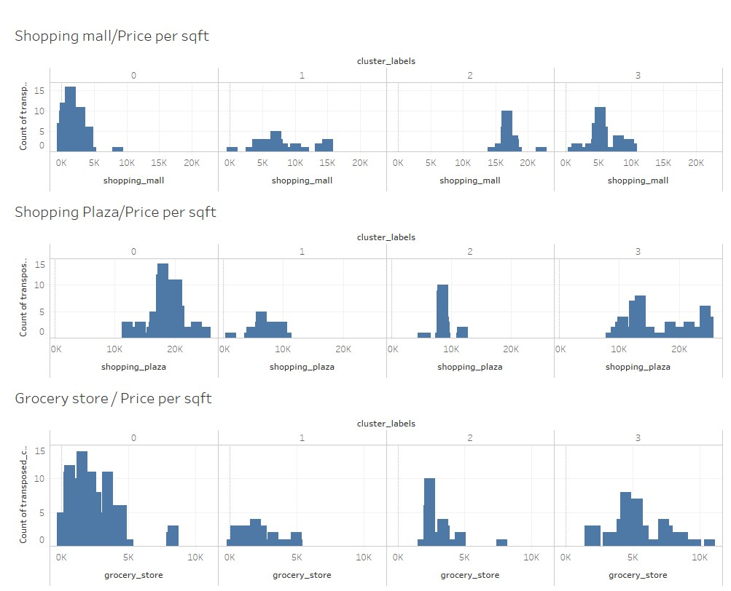
Shopping Options
Properties in cluster two are mostly near shopping options
Properties in cluster three are further away from shopping plazas and grocery stores

Slide 4
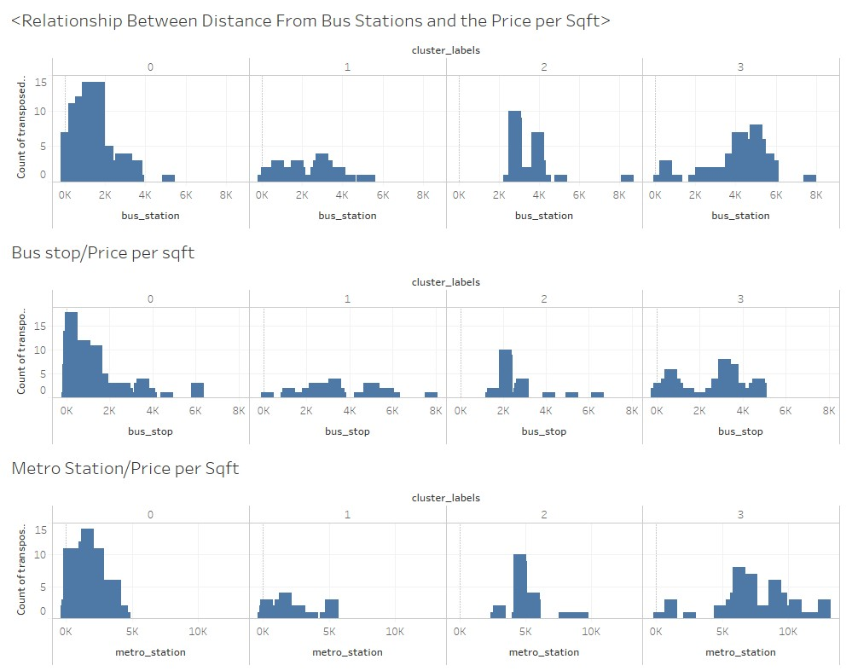
Transit Options
Cluster zero and one are very close to transit stations
Cluster three are the furthest away from transit stations
Properties in cluster two are still close to transit stations but relatively far compared to clusters zero and one

Slide 5
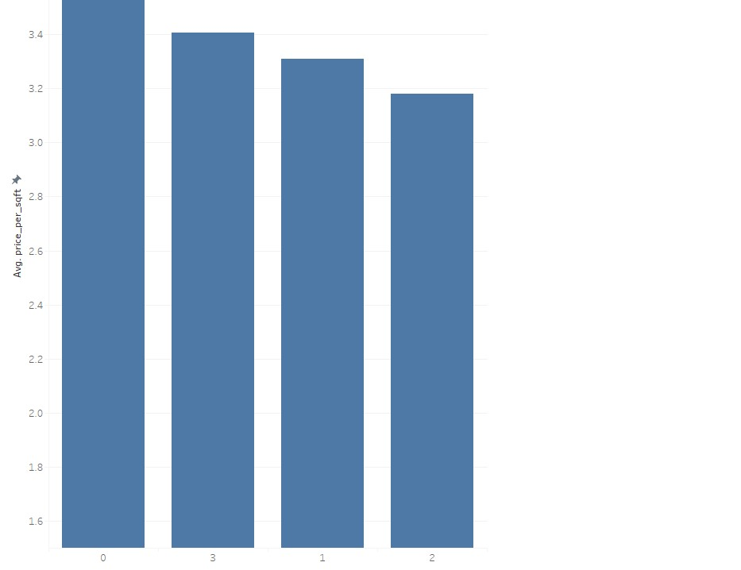
Price comparison
Cluster zero have the highest average rent/sqft
Cluster two have the cheapest rent

Slide 6
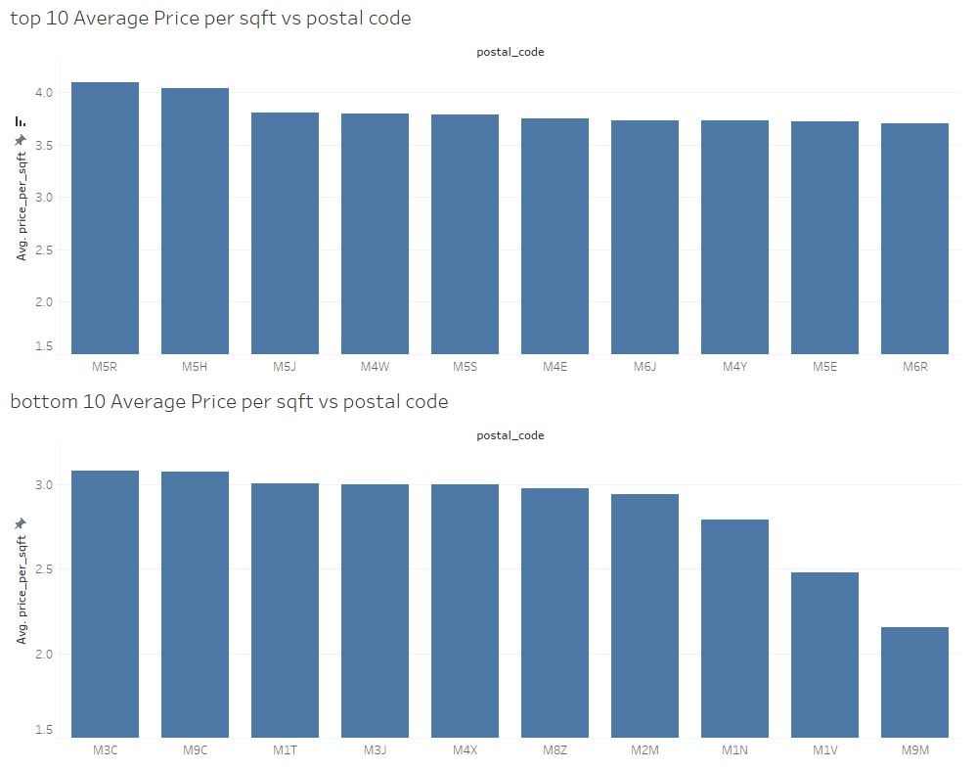
Neighborhood Price Comparison
The neighborhood under “M5J” have the highest rent per sqft
“M4E” is the cheapest neighborhood to rent

Slide 7
Conclusion
Properties in cluster zero are, on average, the most expensive to live in. However, they are closer to transit and shopping centers which is what many tenants look for in a rental neighborhood
Properties in cluster two have very similar characteristics as properties in cluster one but they have the lowest rent per square feet compared to other clusters
Final decision making will depend greatly on habits and needs of the tenants!

